Slide 1
S.LOKESH 2021506043 Madras institute of technology
Gold Price Prediction using CNN
3/21/2024 Annual Review

Slide 2
Gold Price Prediction using CNN
Gold price detection using Convolutional Neural Networks (CNNs) refers to the application of deep learning techniques, specifically CNNs, to predict the future price movements of gold. CNNs are a type of neural network commonly used in image recognition tasks, but they can also be applied to sequential data such as time series, which is relevant to financial data like gold prices.
3/21/2024 Annual Review

Slide 3


AGENDA
Sure, here are three important points to consider when predicting gold prices using CNNs:
Data Quality and Feature Selection: The accuracy of the predictions heavily depends on the quality and relevance of the data used for training the CNN. Ensure that the historical gold price data is clean, consistent, and covers a significant time period. Additionally, consider incorporating relevant features such as economic indicators, geopolitical events, or market sentiment data to enhance the model's predictive power.
Model Architecture Design: Designing an appropriate CNN architecture for time-series forecasting is crucial. Experiment with different architectures, including the number of layers, filter sizes, and pooling strategies, to capture temporal patterns effectively. Consider incorporating techniques such as residual connections or attention mechanisms to improve the model's ability to learn from sequential data.
Evaluation and Monitoring: Evaluate the trained model's performance rigorously using appropriate metrics such as Mean Absolute Error (MAE), Mean Squared Error (MSE), or Root Mean Squared Error (RMSE). Compare the model's predictions against actual gold prices to assess its accuracy and reliability
3/21/2024 Annual Review

Slide 4

PROBLEM STATEMENT
Here's a simplified problem statement for gold price prediction using Convolutional Neural Networks (CNNs) in three points:
Data Representation: The problem involves representing historical data of gold prices in a format suitable for CNNs. This includes organizing time-series data into sequential input tensors, potentially incorporating additional features such as economic indicators or sentiment analysis.
Model Training: Developing and training a CNN architecture capable of learning complex patterns and relationships within the gold price data. This requires careful selection of network architecture, optimization algorithms, and hyperparameters to effectively capture temporal dependencies and non-linear trends in the data.
Prediction Accuracy: The primary objective is to accurately predict future gold prices based on historical data. This involves evaluating the performance of the CNN model in terms of metrics like mean squared error (MSE) or mean absolute error (MAE) on a test dataset, ensuring the model can generalize well to unseen data and make reliable predictions in real-world scenarios.
3/21/2024 Annual Review

Slide 5

PROJECT OVERVIEW
Objective: The primary goal is to leverage the capabilities of CNNs, commonly used in image recognition tasks, to analyze historical gold price data in a sequential manner and extract patterns that can aid in forecasting future price movements.
Methodology: The project involves preprocessing historical gold price data to create a suitable input format for the CNN model. This may include converting time-series data into image-like representations or using sliding windows to create sequential input sequences. The CNN architecture is then designed to analyze these input representations and learn relevant features that correlate with gold price dynamics. Training and validation are conducted using historical data, and the model's performance is evaluated based on its ability to accurately predict future gold prices.
Outcomes: The project aims to generate predictive insights into gold price movements, which can be valuable for investors, traders, and financial analysts. By utilizing CNNs, the model may capture complex patterns and dependencies within the data that traditional statistical methods might overlook. The ultimate outcome is to provide stakeholders with a reliable tool for making informed decisions in gold investment and trading scenarios.
3/21/2024 Annual Review

Slide 6

WHO ARE THE END USERS?
The end users of gold price prediction using Convolutional Neural Networks (CNN) can vary, but typically include:
Investors and Traders: Individuals or institutions involved in trading gold commodities or gold-related financial instruments can utilize CNN-based price predictions to inform their buying and selling decisions. Accurate predictions can help them optimize their investment strategies and potentially maximize profits.
Financial Analysts and Advisors: Professionals in the financial sector, such as analysts and advisors, may use CNN-based gold price predictions to provide insights and recommendations to their clients. These predictions can aid in portfolio management and risk assessment, enabling better-informed decision-making.
Gold Industry Stakeholders: Companies and organizations operating within the gold industry, including miners, refiners, and jewelry manufacturers, can benefit from gold price predictions to anticipate market trends and plan production, inventory management, and pricing strategies accordingly. This helps them adapt to changing market conditions and optimize their operations.
3/21/2024 Annual Review

Slide 7
YOUR SOLUTION AND ITS VALUE PROPOSITION
Accurate Predictions: Utilizing Convolutional Neural Networks (CNNs) for gold price prediction offers the potential for highly accurate forecasts. CNNs are adept at learning complex patterns and relationships within data, making them well-suited for analyzing historical gold price data and identifying trends that may influence future prices.
Real-time Insights: By leveraging CNNs, the gold price prediction model can provide real-time insights into market movements. This enables investors, traders, and financial institutions to make informed decisions quickly, based on up-to-date analyses of gold price trends and fluctuations.
Risk Mitigation: Predicting gold prices with CNNs allows for proactive risk mitigation strategies. By anticipating potential changes in gold prices, stakeholders can adjust their investment portfolios, hedge against risks, and implement trading strategies to minimize losses or maximize returns in volatile market conditions. This proactive approach enhances financial stability and resilience in the face of market uncertainties.
3/21/2024 Annual Review

Slide 8

THE WOW IN YOUR SOLUTION
As can be seen, the price predicted by the model follows the actual prices greatly! The value of Loss and Accuracy (1-MAPE) obtained on the test data also confirm the great performance of the model:
Loss: 0.001
Accuracy: 96%
3/21/2024 Annual Review
8

Slide 9
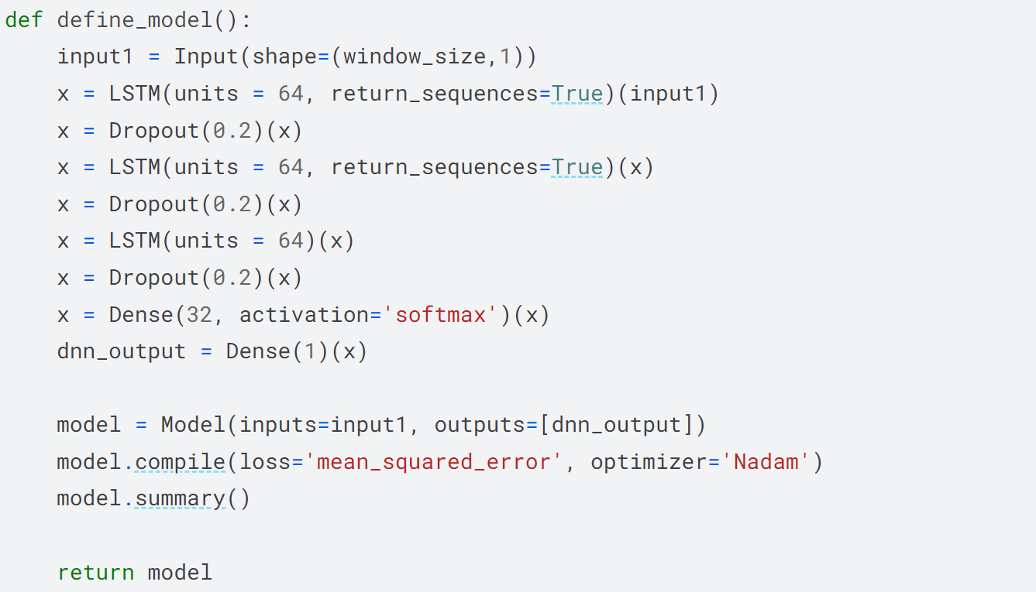
MODELLING
3/21/2024 Annual Review
9

Slide 10
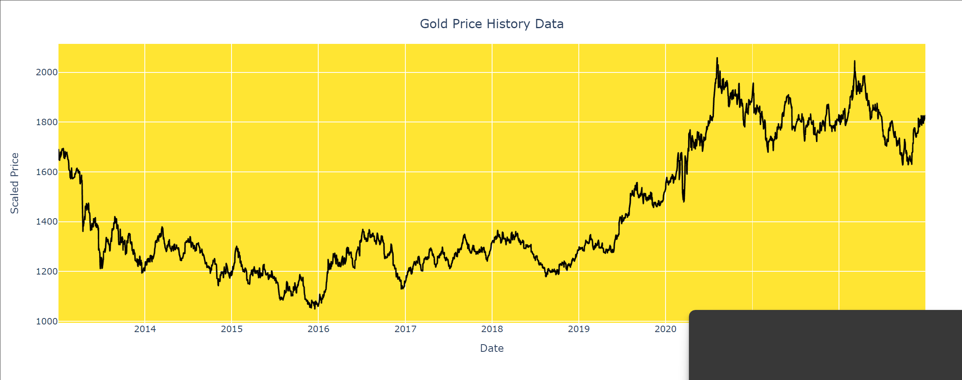
RESULTS
3/21/2024 Annual Review
10

Slide 11
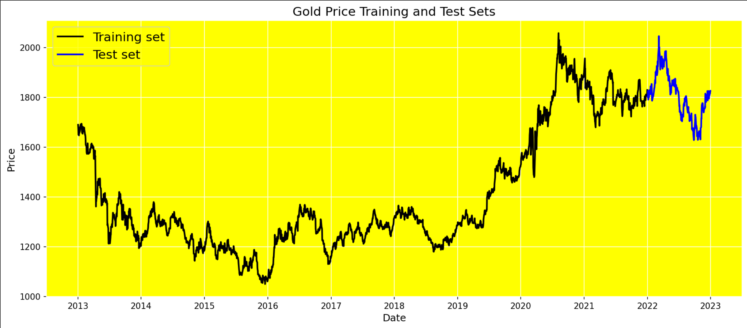
RESULTS
3/21/2024 Annual Review
11

Slide 12
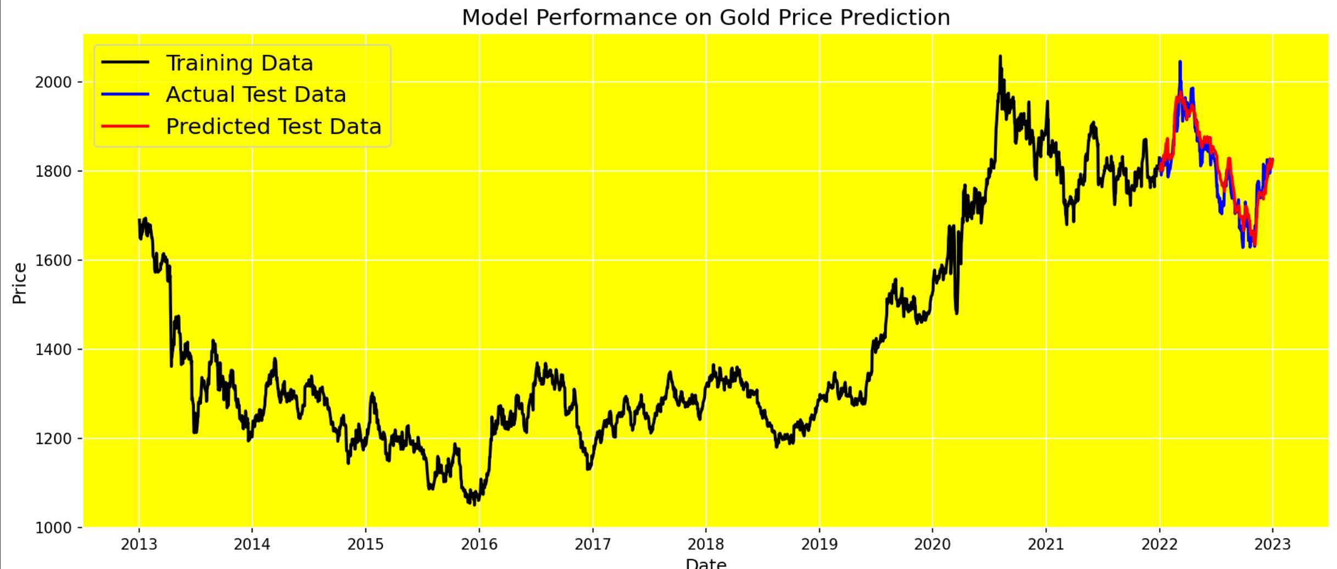
RESULTS
https://colab.research.google.com/drive/1_ayucCYjs8W7rN0nD7J4LOZE5h3gOa8m#scrollTo=UzTeQ_w_TvP-
3/21/2024 Annual Review
12

